Slide 1

MEASURE ENERGY CONSUMTION
USING ARTIFICIAL INTELLIGENCE
NAME : NIVEDHA.V
REG.NO : 212921106055
DEPT/SEM : ECE/5
COLLEGE : 2129-SJCE

Slide 2
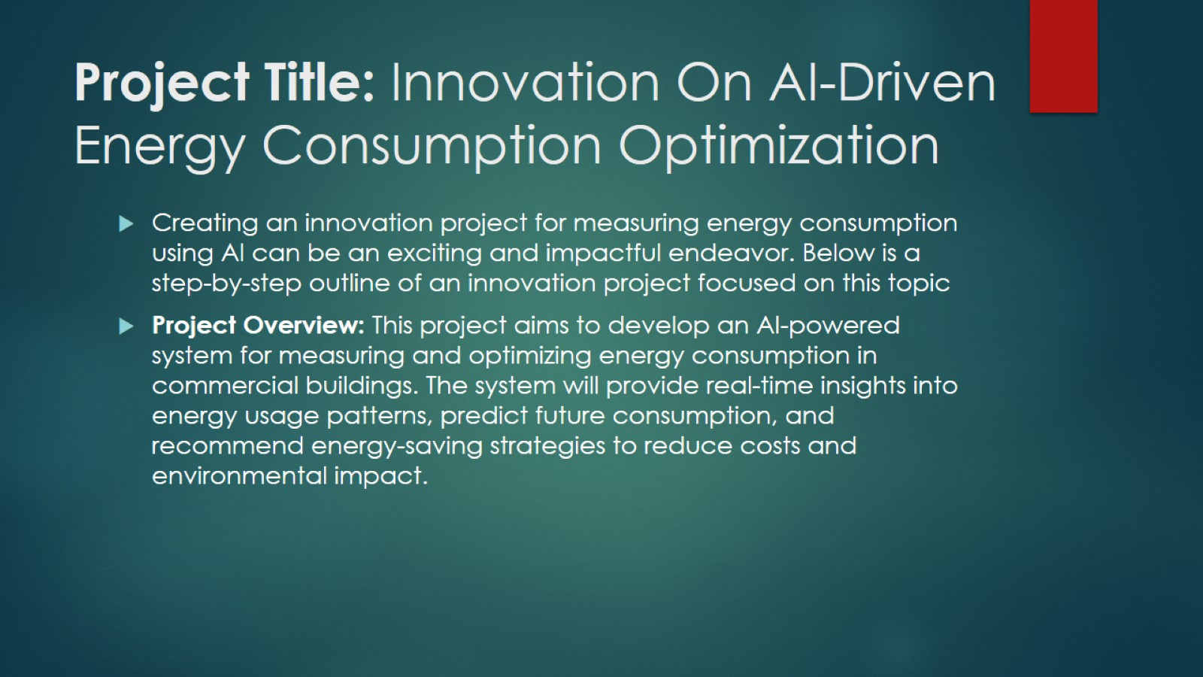
Project Title: Innovation On AI-Driven Energy Consumption Optimization

Slide 3
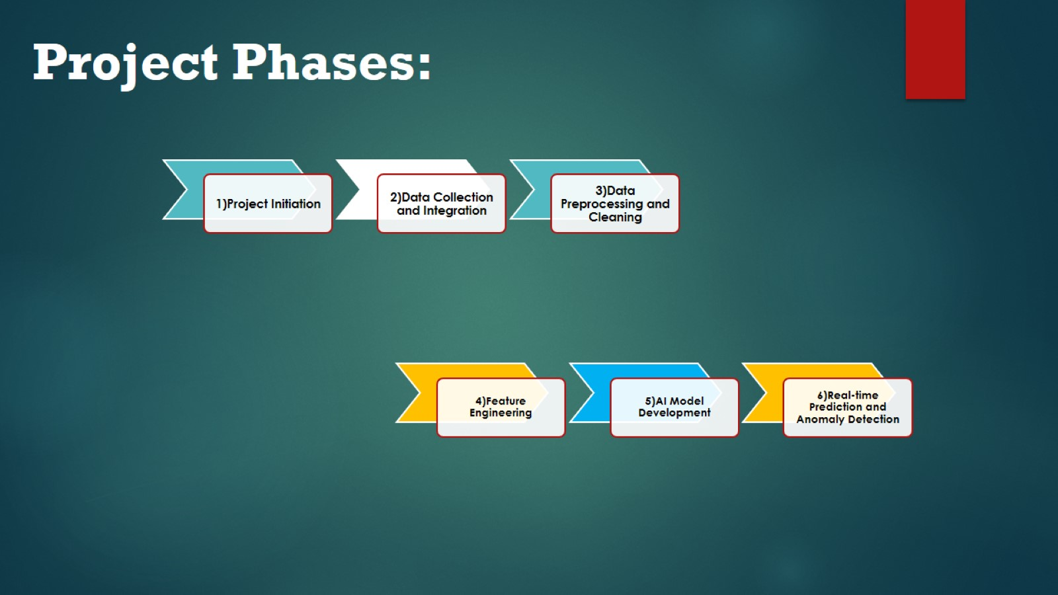

Slide 4
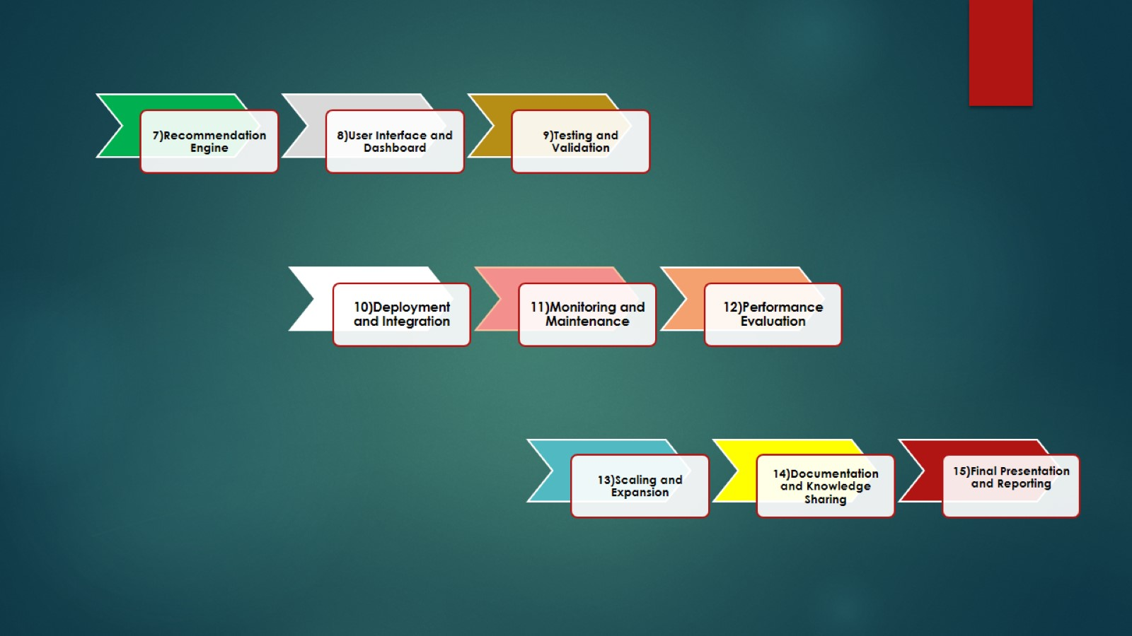

Slide 5
